Slide 1
How to create a link to rerun a prompted Alma Analytics report
Yoel Kortick
Senior Librarian

Slide 2
The question
The report
Adding the link to rerun the report when there are no results
Adding the link to rerun the report when there are results

Slide 3
The question

Slide 4
The question
I have an analytics report that includes a prompt. I want to add a link to the results so that a user can click the link and rerun the report. I want the link to appear both when there are and are not results.
I already know how to change the message (I saw How to change the no results message to a specific message in an Analytics report). I want a link or button though, to rerun the report

Slide 5
The report

Slide 6
The report
We have a report with a prompt. It is run "by itself" and not inside a dashboard.
The report is named "LocalShelfMark_099_List"
We will see soon that the path and report name are included in the link for adding a button to rerun then report.

Slide 7

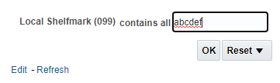
The report
If we click "Open" on the report …
And in the prompt we choose a value which will yield no results …

Slide 8
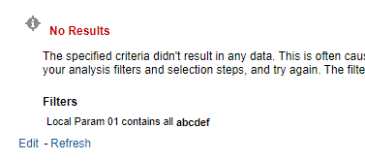
The report
Then we get this:

Slide 9
Adding the link to rerun the report when there are no results

Slide 10
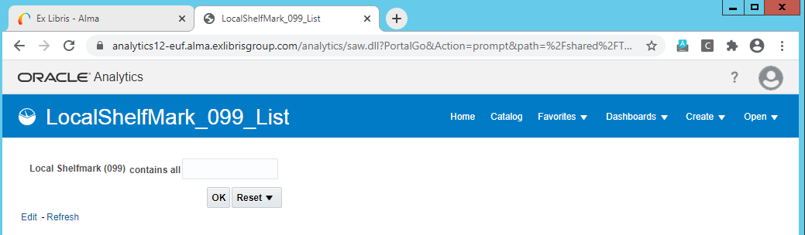
Adding the link to rerun the report when there are no results
When we clicked "Open" the URL which was created is:
https://analytics12-euf.alma.exlibrisgroup.com/analytics/saw.dll?PortalGo&Action=prompt&path=%2Fshared%2FThe%20London%20Library%2044LON_INST%2FReports%2FExl%2FLocalShelfMark_099_List

Slide 11
Adding the link to rerun the report when there are no results
We can use the URL to create a link, and we will make the link be a button. Here is URL (again):
https://analytics12-euf.alma.exlibrisgroup.com/analytics/saw.dll?PortalGo&Action=prompt&path=%2Fshared%2FThe%20London%20Library%2044LON_INST%2FReports%2FExl%2FLocalShelfMark_099_List
Here is the link to the report as a button:
<button onclick="window.location.href='saw.dll?PortalGo&Action=prompt&path=%2Fshared%2FThe%20London%20Library%2044LON_INST%2FReports%2FExl%2FLocalShelfMark_099_List '">Rerun the report</button>

Slide 12
Adding the link to rerun the report when there are no results
Here is syntax for the link:
<button onclick="window.location.href='part of the URL fromsaw.dll to end of report name'">text of button</button>
Here is our real example:
<button onclick="window.location.href='saw.dll?PortalGo&Action=prompt&path=%2Fshared%2FThe%20London%20Library%2044LON_INST%2FReports%2FExl%2FLocalShelfMark_099_List '">Rerun the report</button>
Note: If you copy and paste these examples make sure the quotations marks do not get ruined during the "paste" and if so rewrite them manually.

Slide 13
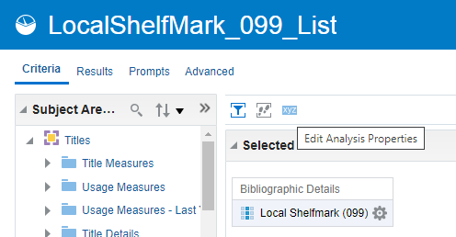
Adding the link to rerun the report when there are no results
From the criteria tab of the report click "edit analysis properties"

Slide 14
Adding the link to rerun the report when there are no results
On the “Edit Analysis Properties” screen (seen on next slide) do as follows:
  Change the "No results settings" to "Display Custom Message"
  In the "Message" section put the link which we just made
  Check the checkbox “Contains HTML Markup”
  If desired also add a header

Slide 15
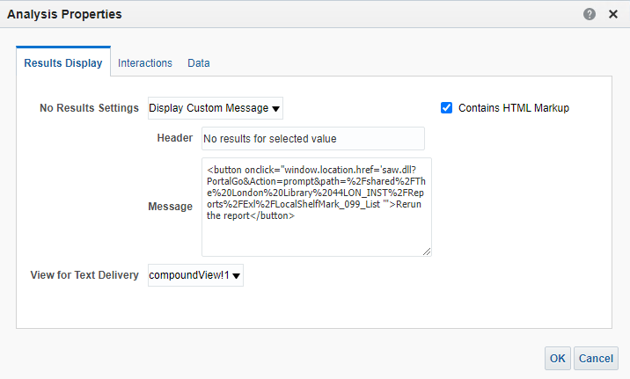
Adding the link to rerun the report when there are no results
We also added a header, but it is not necessary for the link
Check “Contains HTML Markup”

Slide 16
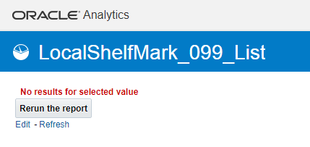
Adding the link to rerun the report when there are no results
Now if we click "Open" on the report and again choose a value which will yield no results we get this
Now we will click the button …

Slide 17
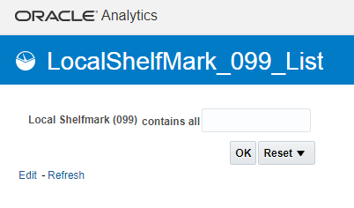
Adding the link to rerun the report when there are no results
And we are prompted to run the report again

Slide 18
Adding the link to rerun the report when there are results

Slide 19
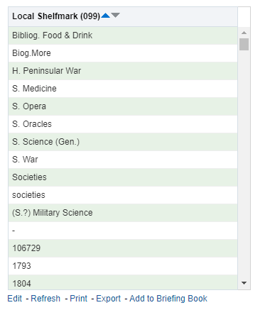
Adding the link to rerun the report when there are results
It is also possible to add the link to rerun the report when there are results
We can add the link here

Slide 20
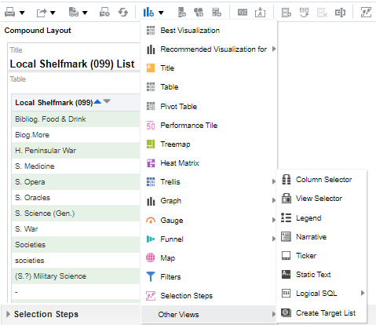
Adding the link to rerun the report when there are results
From the results tab after clicking "edit" click “New View > Other Views” and add a static text

Slide 21

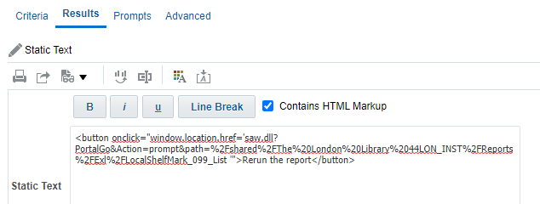
Adding the link to rerun the report when there are results
Edit the static text and put the linking text we already made in the static text and check "contains html markup"

Slide 22
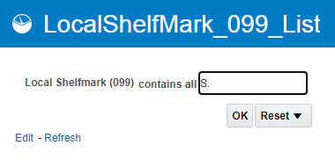
Adding the link to rerun the report when there are results
Now we will run the report again and choose a value which will yield results

Slide 23
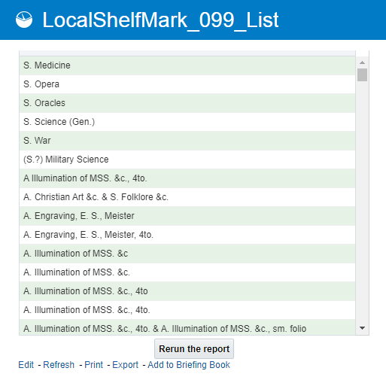
Adding the link to rerun the report when there are results
And from the results we can rerun the report

Slide 24
Thank you!
xxx@exlibrisgroup.com

